Slide 1
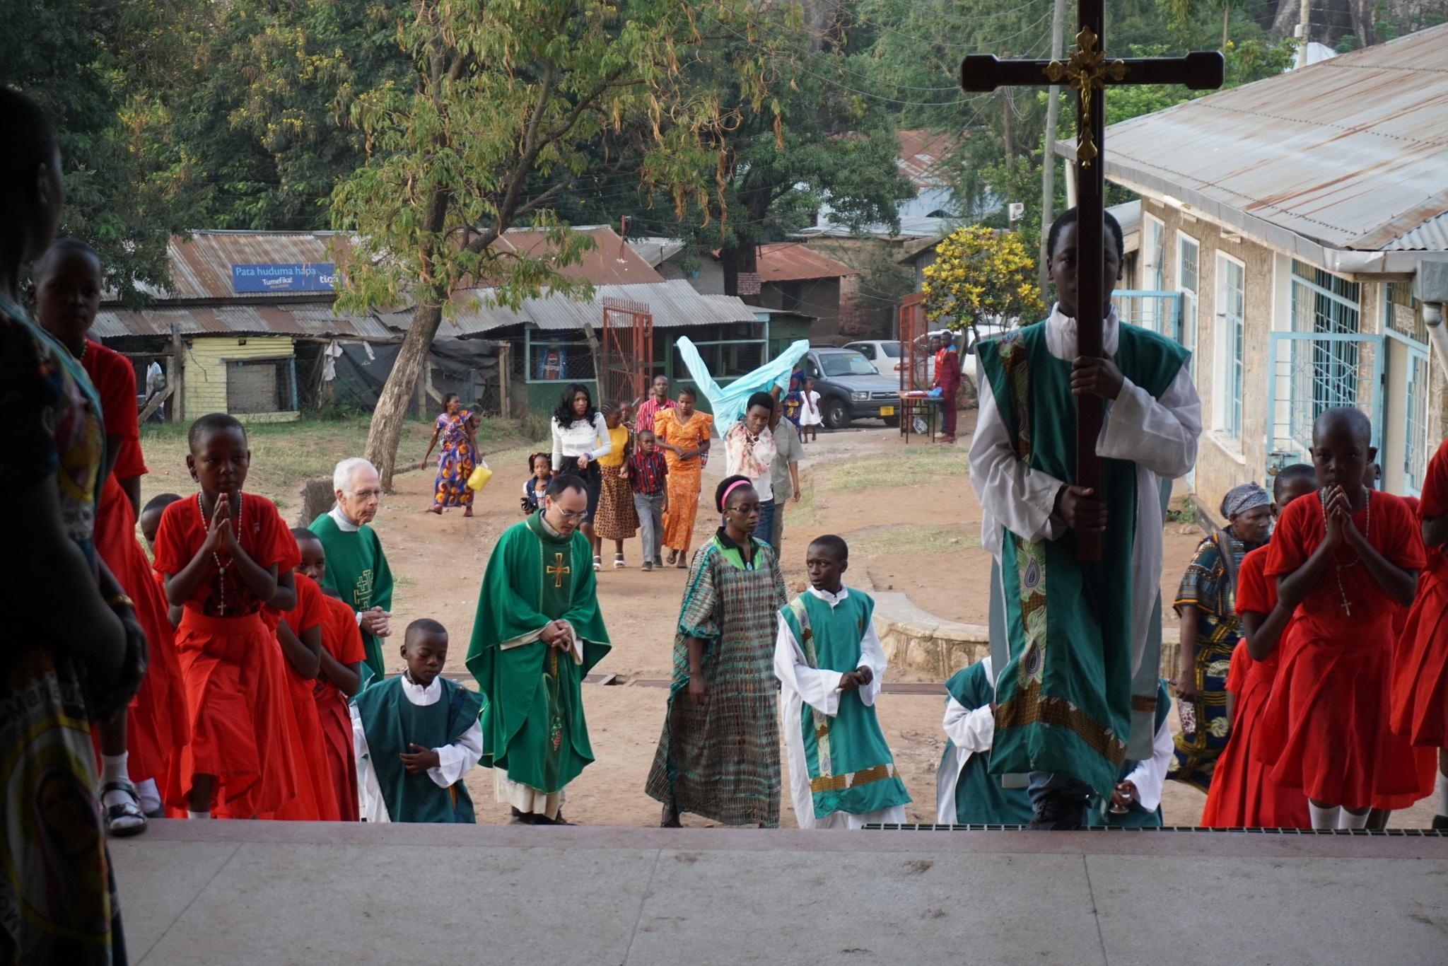
Stations of the Cross
DYN is an interactive education program for teachers, sponsored by

Slide 2
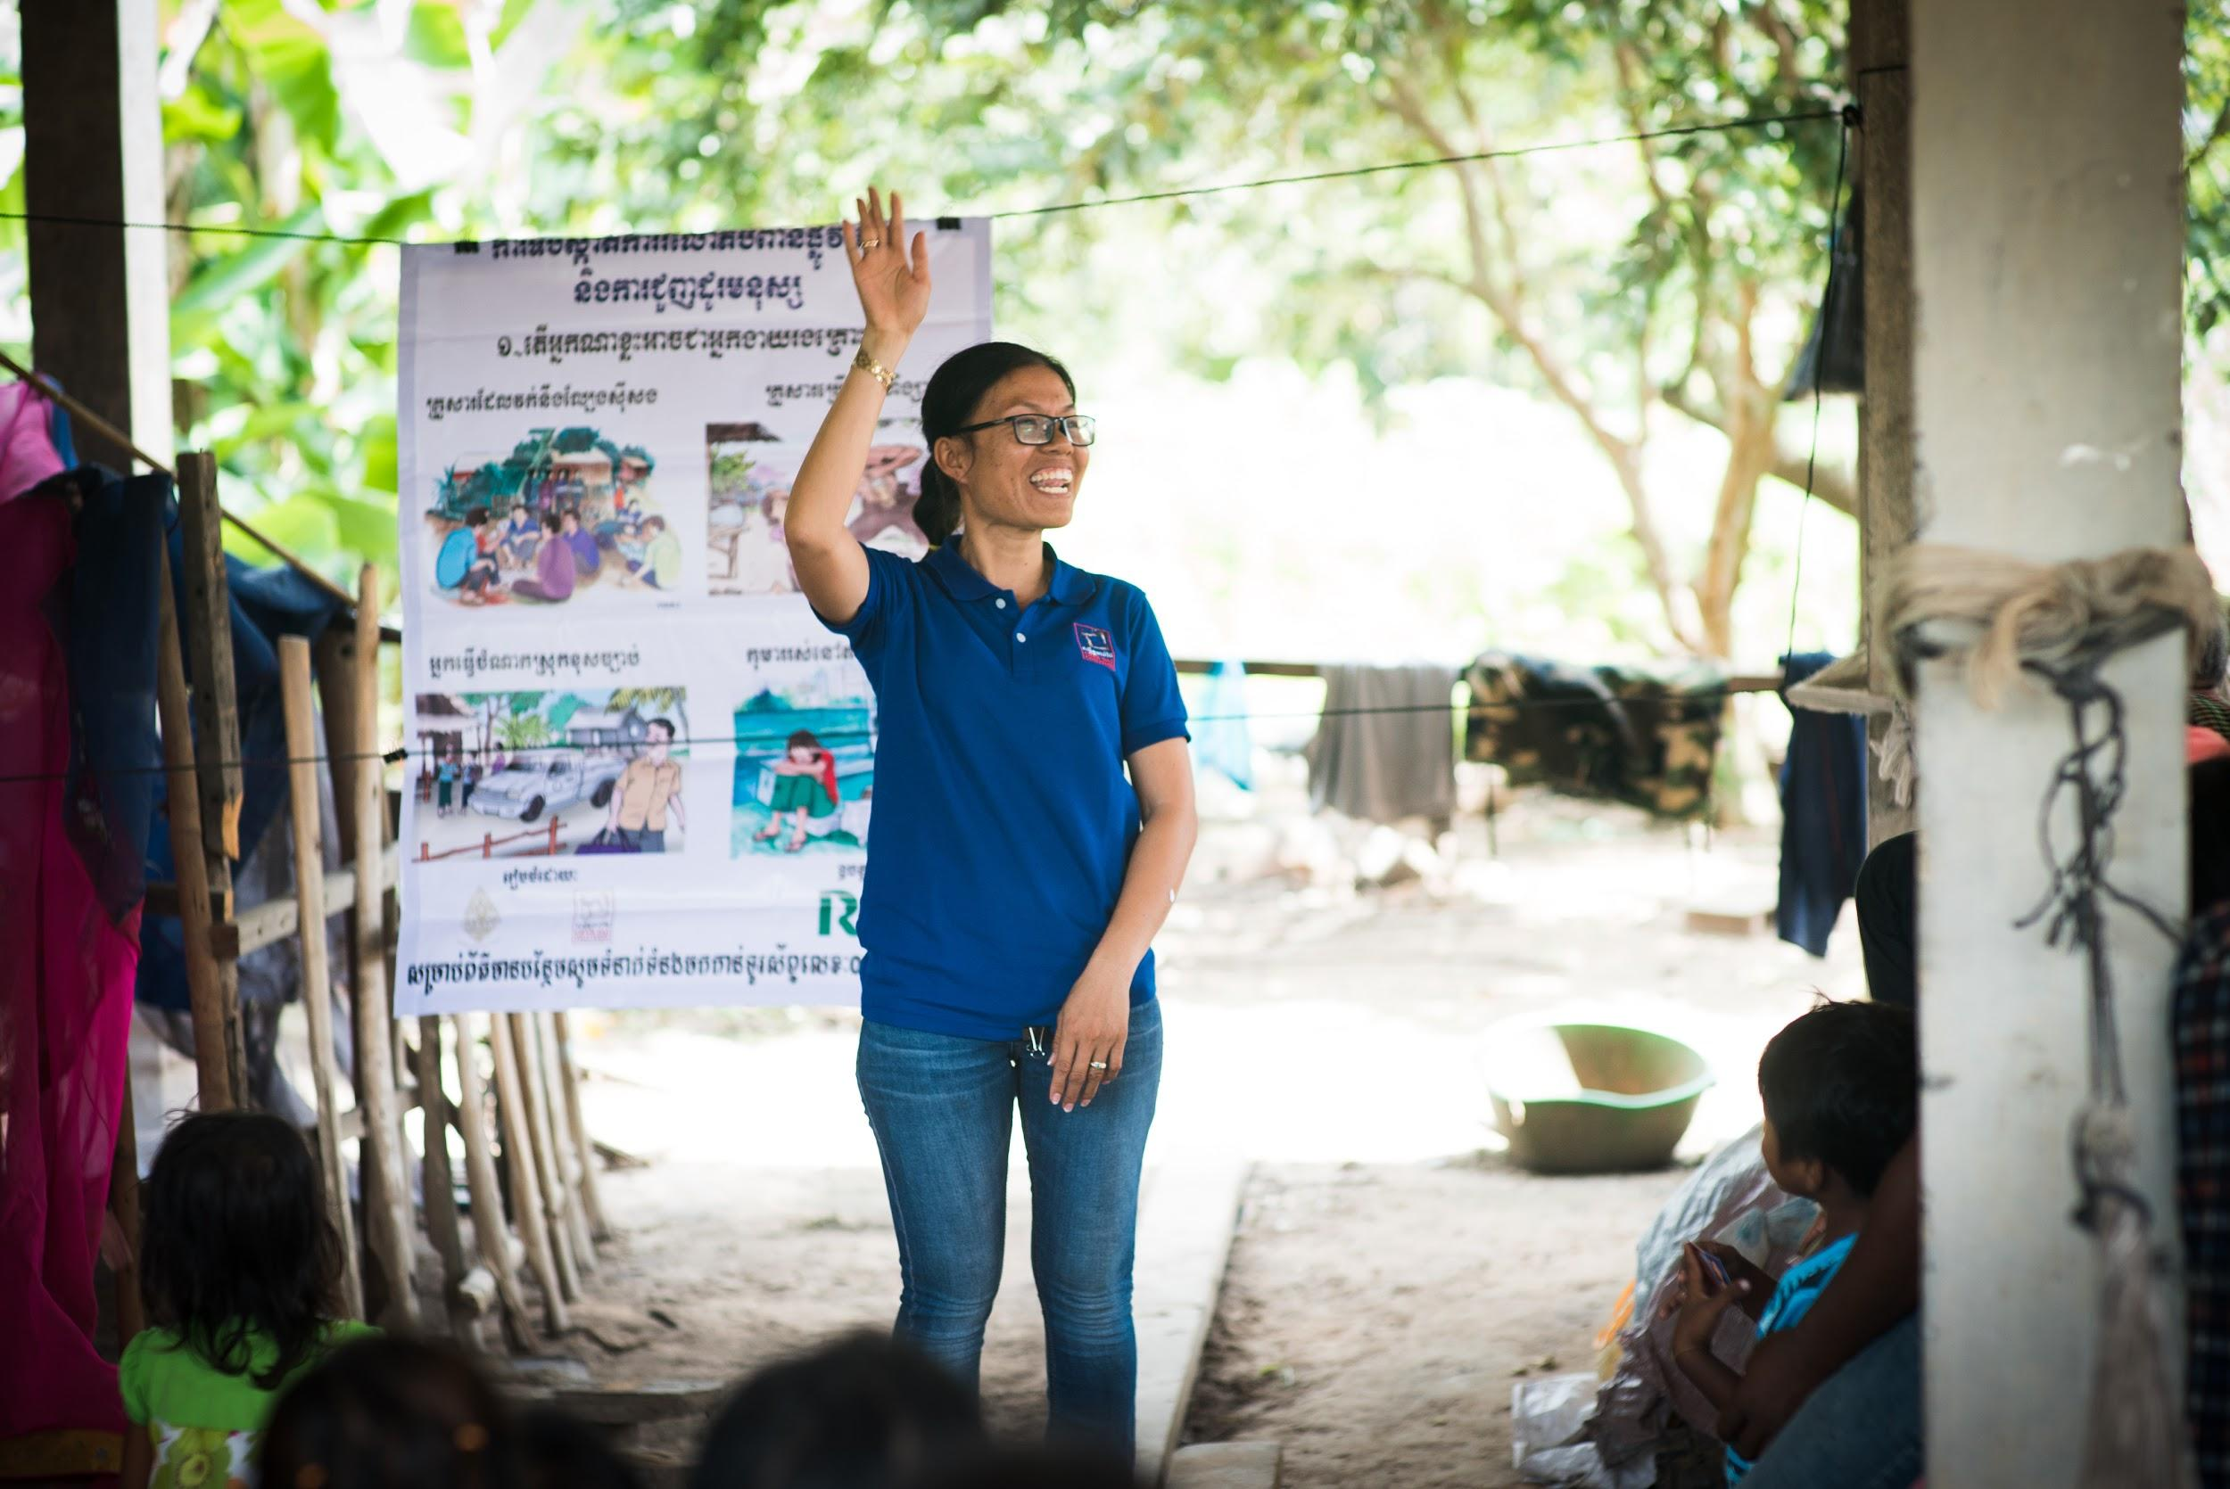
First Station
Pontius Pilate condemns Jesus to death.
For all those working for justice to end human trafficking.
All: Jesus, remember your people.

Slide 3
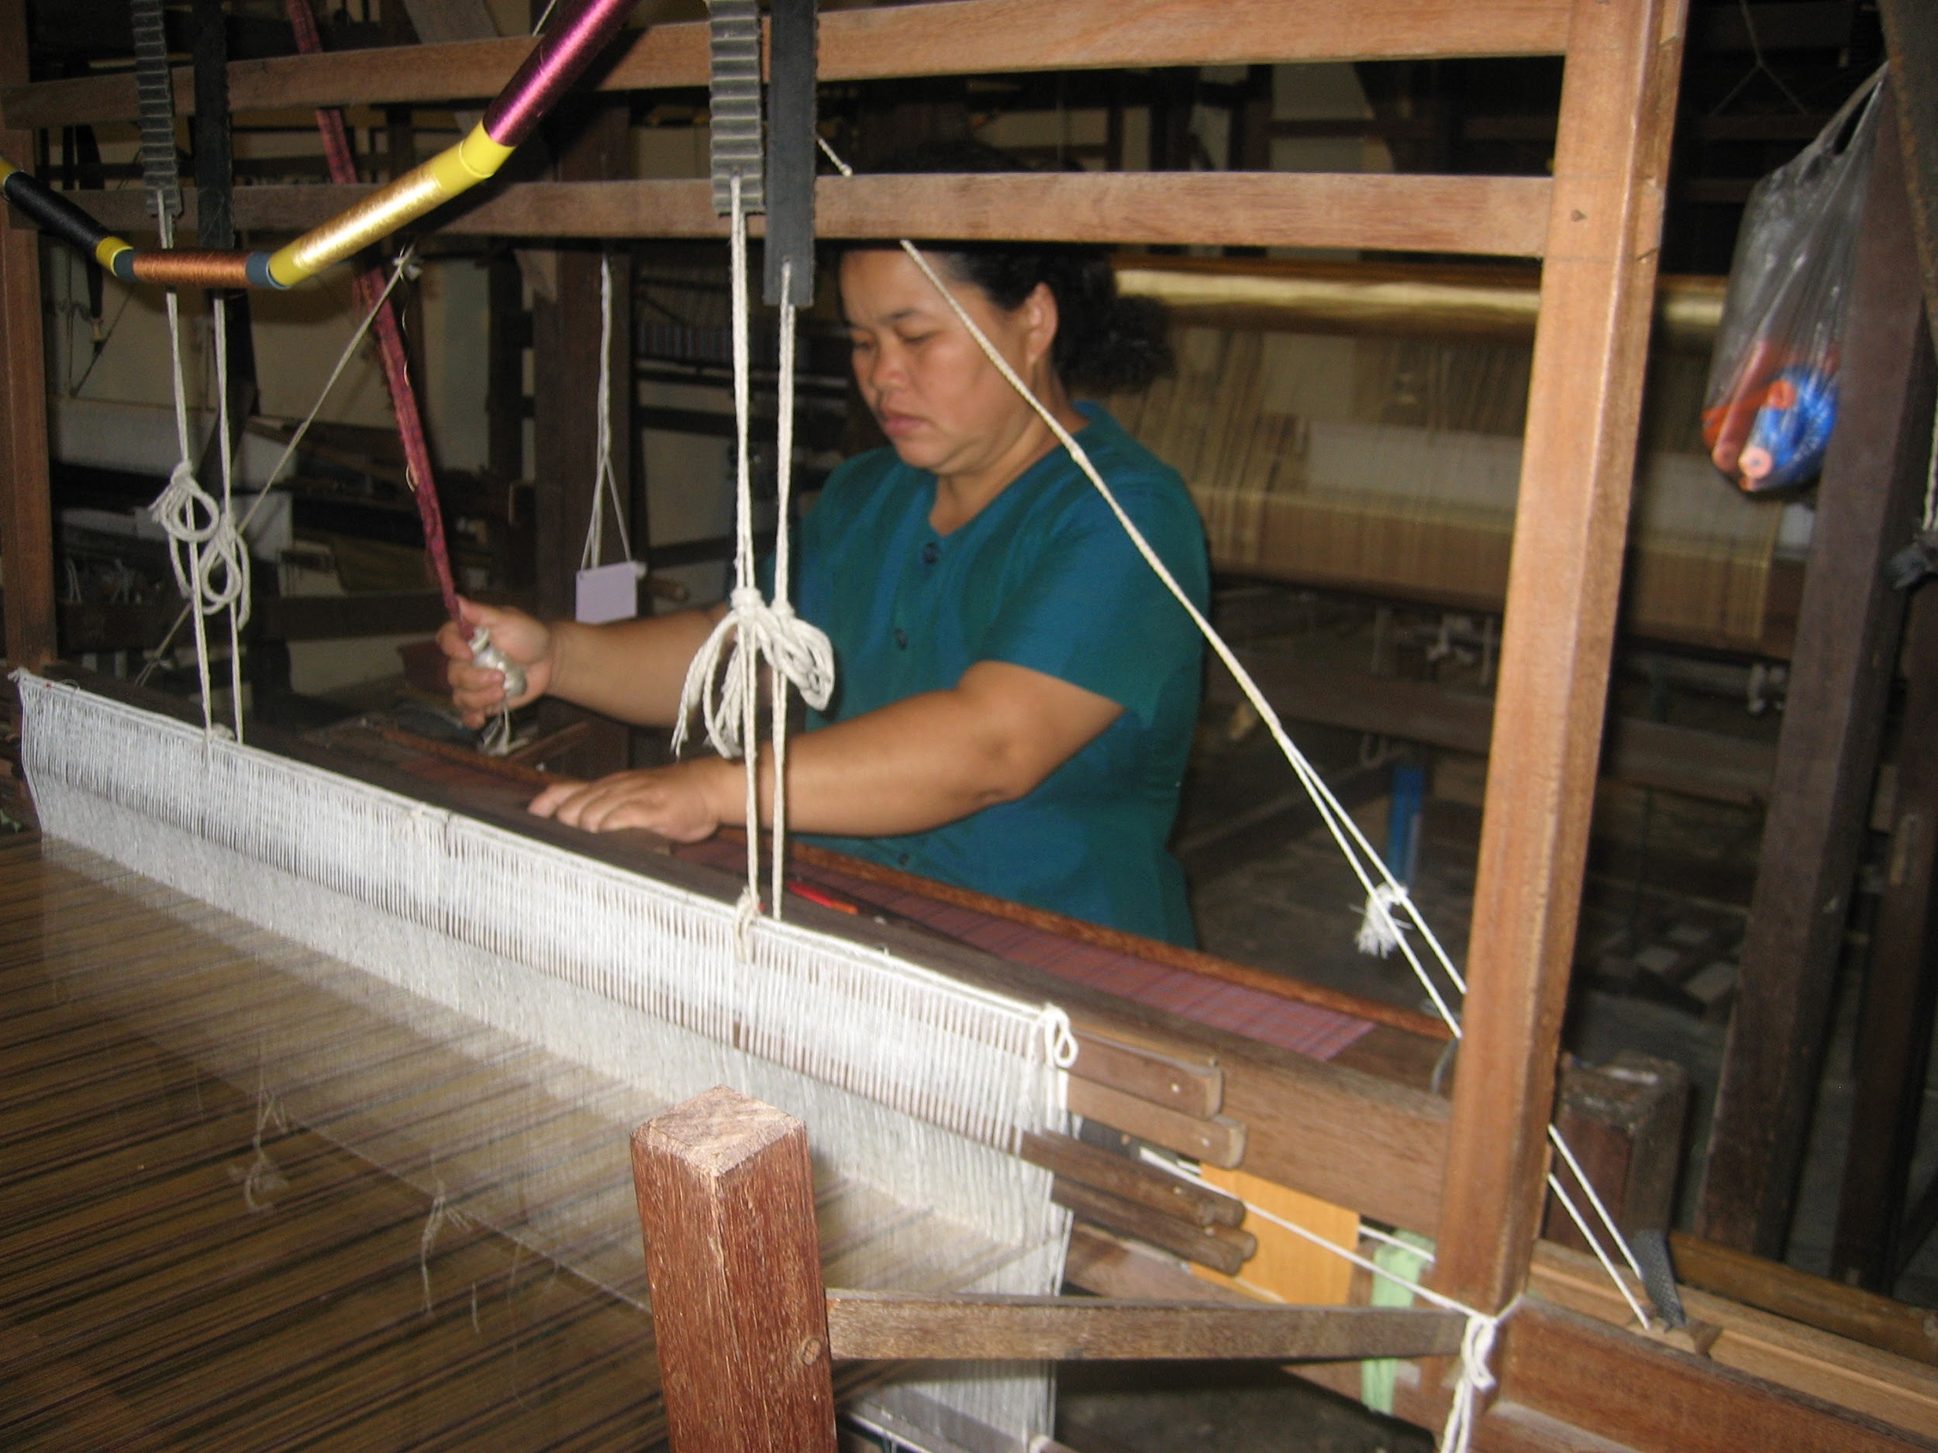
Second Station
Jesus takes up his cross.
For the laborer who is forced to make clothing for 12 hours a day and is paid very little.
All: Jesus, remember your people.

Slide 4
Third Station
Jesus falls the first time.
For the young girl sold into sex slavery.
All: Jesus, remember your people.

Slide 5
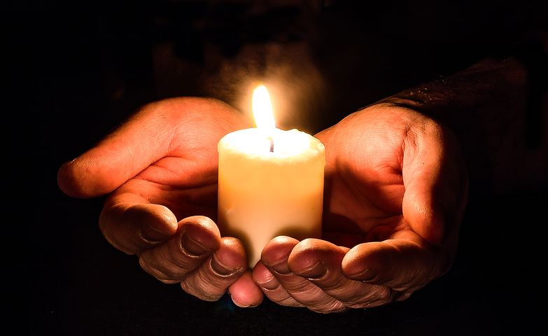
Fourth Station
Jesus meets his
most holy mother.
For the mothers and fathers whose children are missing because they have been trafficked.
All: Jesus, remember your people.

Slide 6
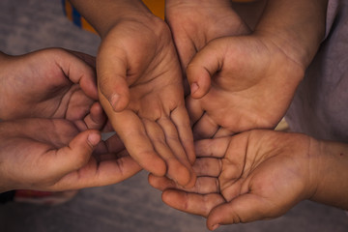
Fifth Station
Simon the Cyrenian helps Jesus carry the cross.
For all those aid workers who sacrifice much to help victims of human trafficking.
All: Jesus, remember your people.

Slide 7
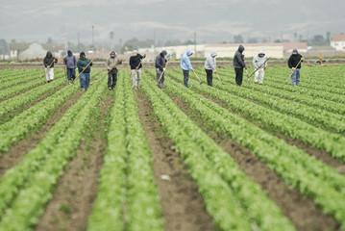
Sixth Station
Veronica wipes the face of Jesus.
For the stranger who offers a drink of water to the day laborer.
All: Jesus, remember your people.

Slide 8
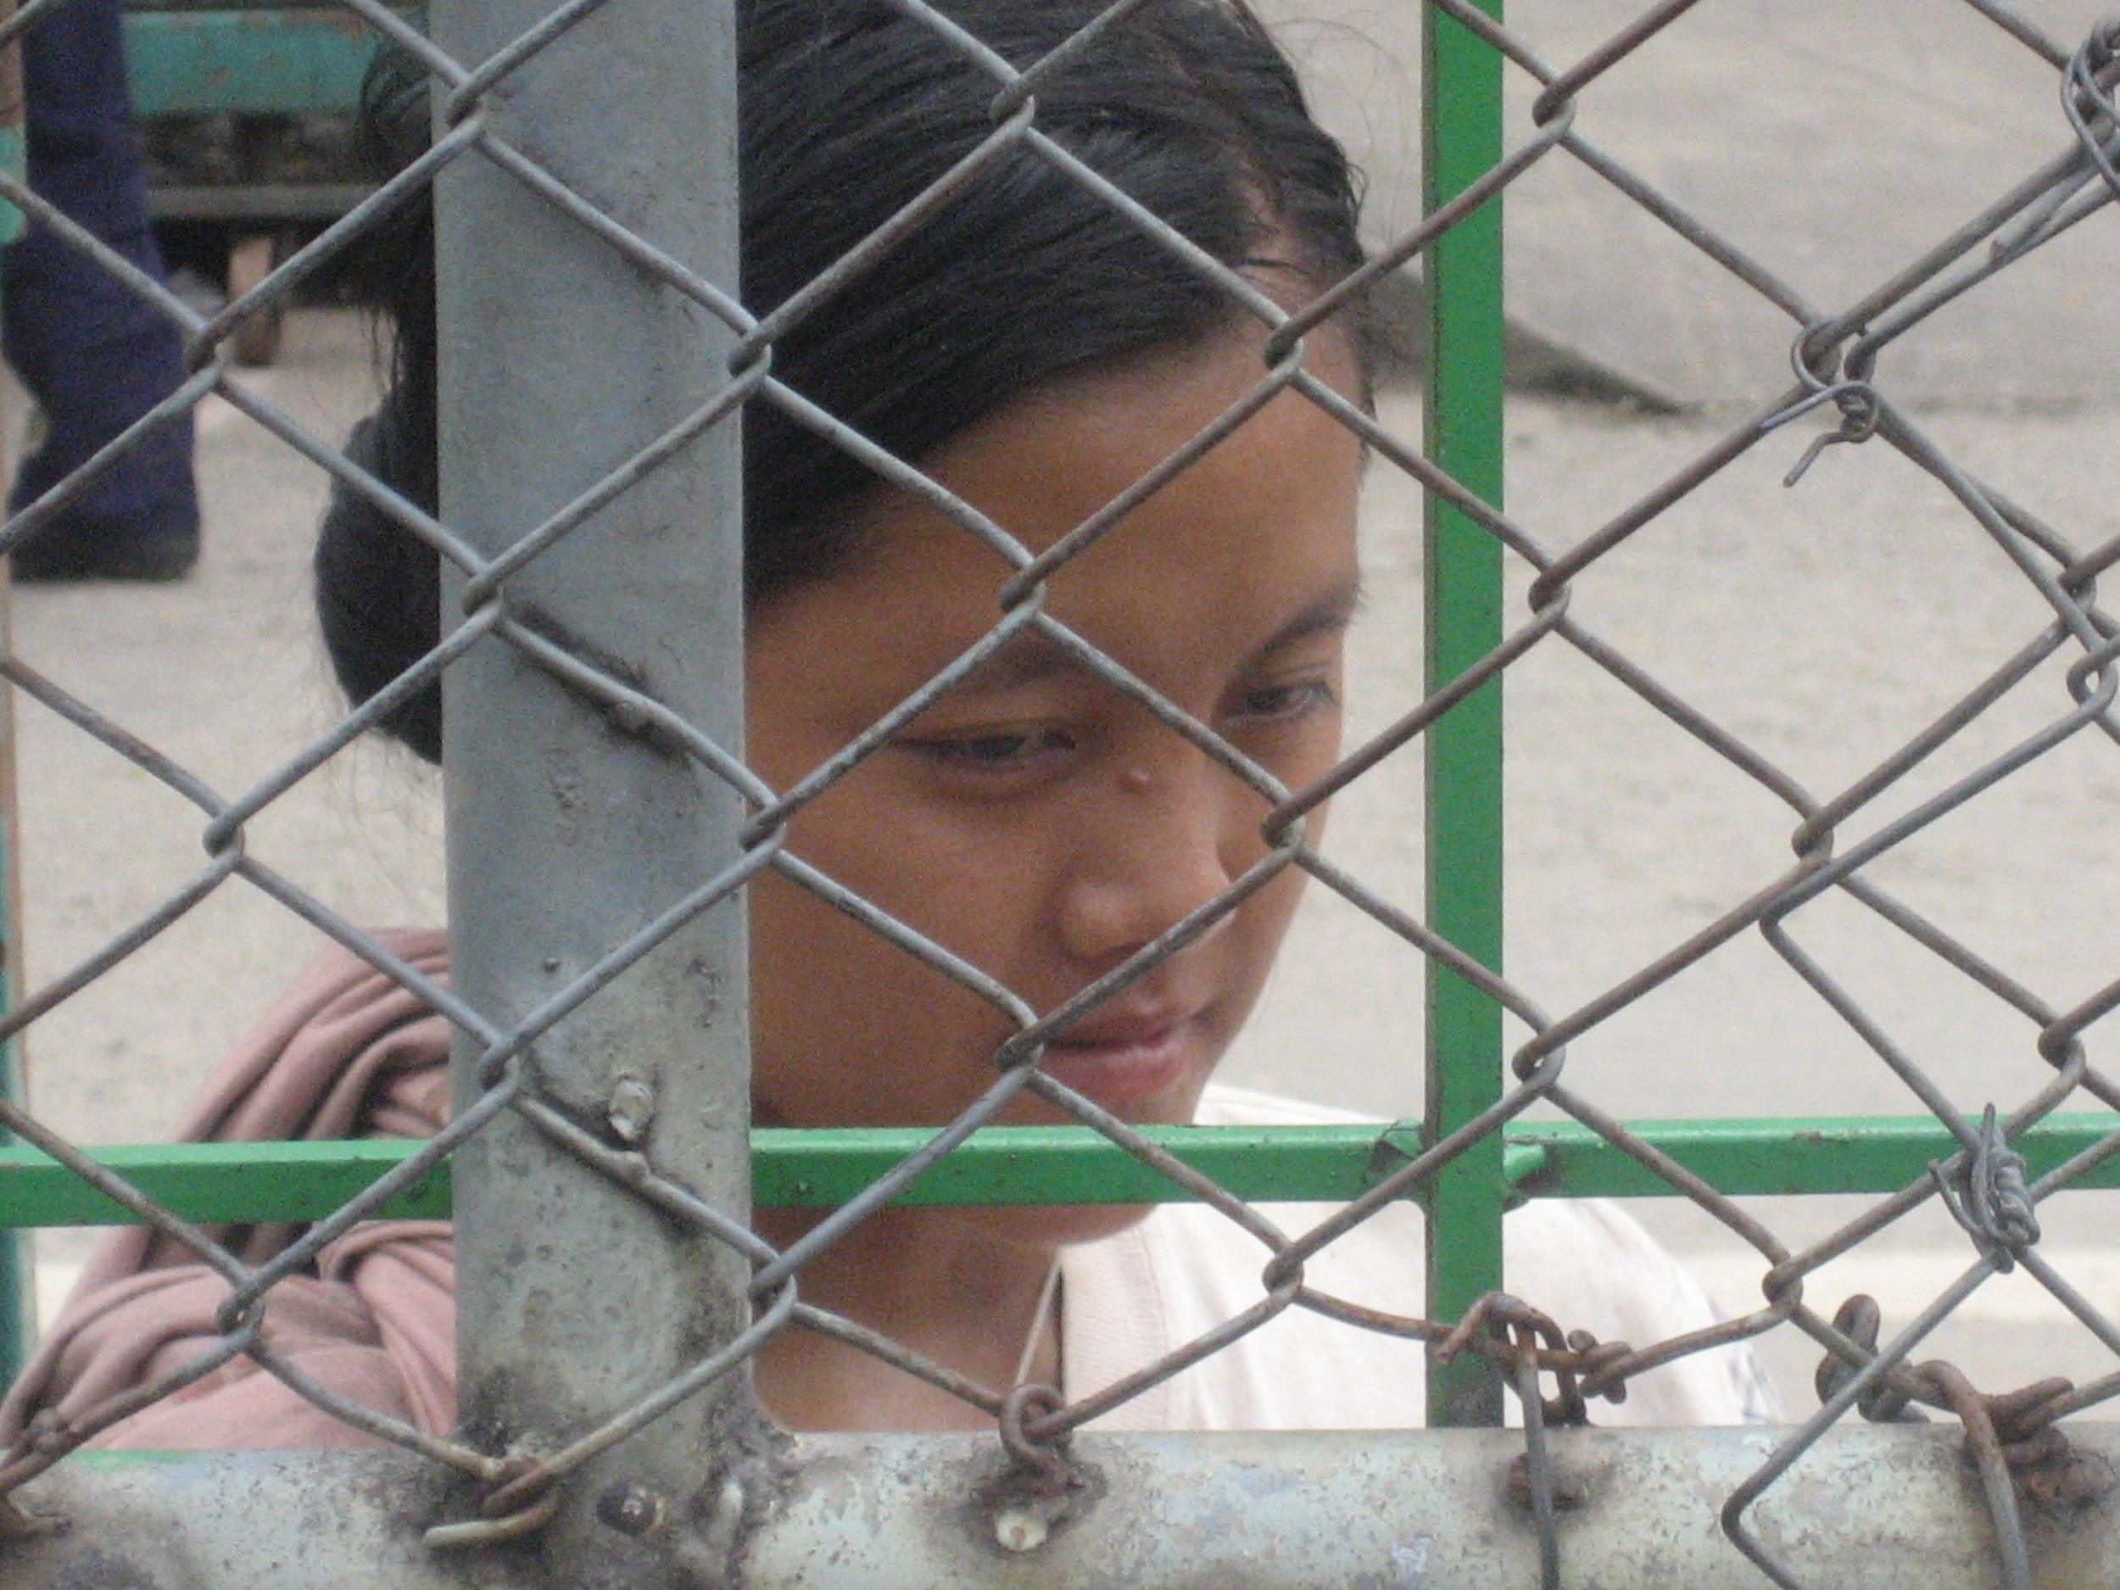
Seventh Station
Jesus falls for the second time.
For the teenagers who believed they were going to another country for a better life and ended up enslaved.
All: Jesus, remember your people.

Slide 9
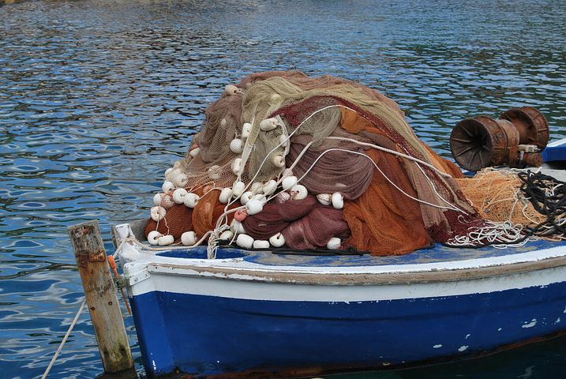
Eighth Station
Jesus meets the weeping women of Jerusalem.
For the families who wait in sorrow for their loved ones to return from a fishing boat that never lets their workers leave.
All: Jesus, remember your people.

Slide 10
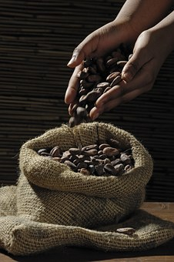
Ninth Station
Jesus falls a third time
For the child forced to pick the cocoa bean to make chocolate.
All: Jesus, remember your people.

Slide 11
Tenth Station
Jesus is stripped of his garments.
For the nanny brought from another country and not allowed to leave the home.
All: Jesus, remember your people.

Slide 12
Eleventh Station
Jesus is nailed to the cross.
For the miners harvesting the minerals for our smartphones who never receive their wages.
All: Jesus, remember your people.

Slide 13
Twelfth Station
Jesus dies on the cross.
For those who are taken captive so that their organs can be taken and sold on the black market.
All: Jesus, remember your people.

Slide 14
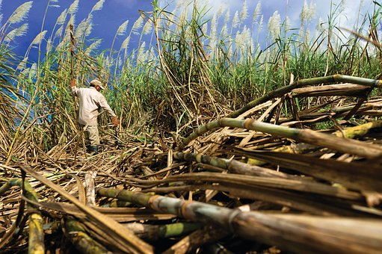
Thirteenth Station:
Jesus is laid in the arms of his most holy mother.
For the farmer chopping down sugar cane who only receives ¼ of his wages.
All: Jesus, remember your people.

Slide 15
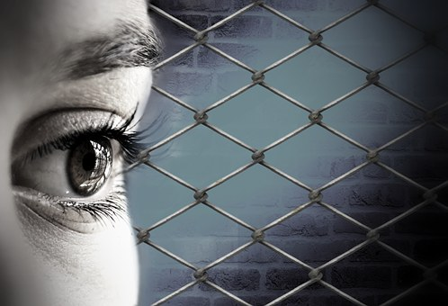
Fourteenth Station
Jesus is laid in
the tomb.
For the survivors of human trafficking, that others may take the time to listen to their stories.
All: Jesus, remember your people.

